Slide 1

Computer Architecture and Logic Design (CALD) Lecture 05
Engr.Ramsha Mashood
Senior Lecturer
Department of Software Engineering
Bahria University Karachi Campus
Email: ramshamashood.bukc@bahria.edu.pk

Slide 2
Input / Output

Slide 3
I/O Module
I/O module has two major functions:
Interface to the processor and memory via the system bus
Interface to one or more peripheral devices by tailored data links
Notes:
Thus, an I/O module is required. This module has two major functions
(Figure 7.1):
• Interface to the processor and memory via the system bus or central switch
• Interface to one or more peripheral devices by tailored data links
We begin this chapter with a brief discussion of external devices, followed by
an overview of the structure and function of an I/O module. Then we look at the
various ways in which the I/O function can be performed in cooperation with the
processor and memory: the internal I/O interface. Finally, we examine the external
I/O interface, between the I/O module and the outside world.

Slide 4
External Devices
Three categories:
Human readable
Suitable for communicating with the computer user
Video display terminals (VDTs), printers
Machine readable
Suitable for communicating with equipment
Magnetic disk and tape systems, sensors and actuators
Communication
Suitable for communicating with remote devices such as a terminal, a machine readable device, or another computer
Provide a means of exchanging data between the external environment and the computer
Attach to the computer by a link to an I/O module
The link is used to exchange control, status, and data between the I/O module and the external device
Peripheral device
An external device connected to an I/O module
Notes:
I/O operations are accomplished through a wide assortment of external devices
that provide a means of exchanging data between the external environment
and the computer. An external device attaches to the computer by a link to
an I/O module (Figure 7.1). The link is used to exchange control, status, and
data between the I/O module and the external device. An external device connected
to an I/O module is often referred to as a peripheral device or, simply, a
peripheral.
We can broadly classify external devices into three categories:
• Human readable: Suitable for communicating with the computer user
• Machine readable: Suitable for communicating with equipment
• Communication: Suitable for communicating with remote devices
Examples of human-readable devices are video display terminals (VDTs) and
printers. Examples of machine-readable devices are magnetic disk and tape systems,
and sensors and actuators, such as are used in a robotics application. Note
that we are viewing disk and tape systems as I/O devices in this chapter, whereas
in Chapter 6 we viewed them as memory devices. From a functional point of view,
these devices are part of the memory hierarchy, and their use is appropriately discussed
in Chapter 6. From a structural point of view, these devices are controlled by
I/O modules and are hence to be considered in this chapter.
Communication devices allow a computer to exchange data with a remote
device, which may be a human-readable device, such as a terminal, a machine readable
device, or even another computer.

Slide 5
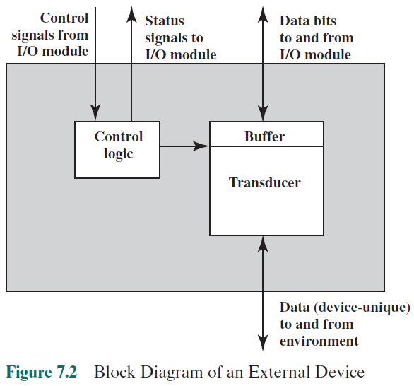
Notes:
In very general terms, the nature of an external device is indicated in
Figure 7.2. The interface to the I/O module is in the form of control, data, and status
signals. Control signals determine the function that the device will perform, such as
send data to the I/O module (INPUT or READ), accept data from the I/O module
(OUTPUT or WRITE), report status, or perform some control function particular
to the device (e.g., position a disk head). Data are in the form of a set of bits to
be sent to or received from the I/O module. Status signals indicate the state of the
device. Examples are READY/NOT-READY to show whether the device is ready
for data transfer.
Control logic associated with the device controls the device’s operation in
response to direction from the I/O module. The transducer converts data from electrical
to other forms of energy during output and from other forms to electrical
during input. Typically, a buffer is associated with the transducer to temporarily
hold data being transferred between the I/O module and the external environment.
A buffer size of 8 to 16 bits is common for serial devices, whereas block-
oriented devices such as disk drive controllers may have much larger buffers.
The interface between the I/O module and the external device will be examined
in Section 7.7. The interface between the external device and the environment
is beyond the scope of this book, but several brief examples are given here.
A disk drive contains electronics for exchanging data, control, and status signals with
an I/O module plus the electronics for controlling the disk read/write mechanism.
In a fixed-head disk, the transducer is capable of converting between the magnetic
patterns on the moving disk surface and bits in the device’s buffer (Figure 7.2). A
Moving-head disk must also be able to cause the disk arm to move radially in and
out across the disk’s surface.

Slide 6
I/O Module Interface
Control Signals
Control signals determine the function that the device will perform, such as
send data to the I/O module (INPUT or READ),
accept data from the I/O module (OUTPUT or WRITE)
Status Signals
Status signals indicate the state of the device.
Examples are READY/NOT-READY to show whether the device is ready for data transfer.
Data are in the form of a set of bits to be sent to or received from the I/O module.
Notes:
In very general terms, the nature of an external device is indicated in
Figure 7.2. The interface to the I/O module is in the form of control, data, and status
signals. Control signals determine the function that the device will perform, such as
send data to the I/O module (INPUT or READ), accept data from the I/O module
(OUTPUT or WRITE), report status, or perform some control function particular
to the device (e.g., position a disk head). Data are in the form of a set of bits to
be sent to or received from the I/O module. Status signals indicate the state of the
device. Examples are READY/NOT-READY to show whether the device is ready
for data transfer.
Control logic associated with the device controls the device’s operation in
response to direction from the I/O module. The transducer converts data from electrical
to other forms of energy during output and from other forms to electrical
during input. Typically, a buffer is associated with the transducer to temporarily
hold data being transferred between the I/O module and the external environment.
A buffer size of 8 to 16 bits is common for serial devices, whereas block-
oriented devices such as disk drive controllers may have much larger buffers.
The interface between the I/O module and the external device will be examined
in Section 7.7. The interface between the external device and the environment
is beyond the scope of this book, but several brief examples are given here.
A disk drive contains electronics for exchanging data, control, and status signals with
an I/O module plus the electronics for controlling the disk read/write mechanism.
In a fixed-head disk, the transducer is capable of converting between the magnetic
patterns on the moving disk surface and bits in the device’s buffer (Figure 7.2). A
Moving-head disk must also be able to cause the disk arm to move radially in and
out across the disk’s surface.

Slide 7
The major functions for an I/O module fall into the following categories:
Control and timing
Coordinates the flow of traffic between internal resources and external devices
Processor communication
Involves command decoding, data, status reporting, address recognition
Device communication
Involves commands, status information, and data
Data buffering
Performs the needed buffering operation to balance device and memory speeds
Error detection
Detects and reports transmission errors
Notes:
The major functions or requirements for an I/O module fall into the following
categories:
• Control and timing
• Processor communication
• Device communication
• Data buffering
• Error detection
During any period of time, the processor may communicate with one or more
external devices in unpredictable patterns, depending on the program’s need for I/O.
The internal resources, such as main memory and the system bus, must be shared
among a number of activities, including data I/O. Thus, the I/O function includes a
control and timing requirement, to coordinate the flow of traffic between internal
resources and external devices. For example, the control of the transfer of data from
an external device to the processor might involve the following sequence of steps:
1. The processor interrogates the I/O module to check the status of the attached
device.
2. The I/O module returns the device status.
3. If the device is operational and ready to transmit, the processor requests the
transfer of data, by means of a command to the I/O module.
4. The I/O module obtains a unit of data (e.g., 8 or 16 bits) from the external device.
5. The data are transferred from the I/O module to the processor.
If the system employs a bus, then each of the interactions between the processor
and the I/O module involves one or more bus arbitrations.
The preceding simplified scenario also illustrates that the I/O module must
communicate with the processor and with the external device. Processor communication
involves the following:
• Command decoding: The I/O module accepts commands from the processor,
typically sent as signals on the control bus. For example, an I/O module for a
disk drive might accept the following commands: READ SECTOR, WRITE
SECTOR, SEEK track number, and SCAN record ID. The latter two commands
each include a parameter that is sent on the data bus.
• Data: Data are exchanged between the processor and the I/O module over the
data bus.
• Status reporting: Because peripherals are so slow, it is important to know the
status of the I/O module. For example, if an I/O module is asked to send data
to the processor (read), it may not be ready to do so because it is still working
on the previous I/O command. This fact can be reported with a status signal.
Common status signals are BUSY and READY. There may also be signals to
report various error conditions.
• Address recognition: Just as each word of memory has an address, so does
each I/O device. Thus, an I/O module must recognize one unique address for
each peripheral it controls.
On the other side, the I/O module must be able to perform device communication.
This communication involves commands, status information, and data
(Figure 7.2).
An essential task of an I/O module is data buffering. The need for this function
is apparent from Figure 2.1. Whereas the transfer rate into and out of main
memory or the processor is quite high, the rate is orders of magnitude lower for
many peripheral devices and covers a wide range. Data coming from main memory
are sent to an I/O module in a rapid burst. The data are buffered in the I/O module
and then sent to the peripheral device at its data rate. In the opposite direction, data
are buffered so as not to tie up the memory in a slow transfer operation. Thus, the
I/O module must be able to operate at both device and memory speeds. Similarly, if
the I/O device operates at a rate higher than the memory access rate, then the I/O
module performs the needed buffering operation.
Finally, an I/O module is often responsible for error detection and for subsequently
reporting errors to the processor. One class of errors includes mechanical
and electrical malfunctions reported by the device (e.g., paper jam, bad disk track).
Another class consists of unintentional changes to the bit pattern as it is transmitted
from device to I/O module. Some form of error-detecting code is often used
to detect transmission errors. A simple example is the use of a parity bit on each
character of data. For example, the IRA character code occupies 7 bits of a byte.
The eighth bit is set so that the total number of 1s in the byte is even (even parity)
or odd (odd parity). When a byte is received, the I/O module checks the parity to
determine whether an error has occurred.

Slide 8
Transfer of Data from External Device to Processor
The processor interrogates the I/O module to check the status of the attached device.
The I/O module returns the device status.
If the device is operational and ready to transmit, the processor requests the transfer of data, by means of a command to the I/O module.
The I/O module obtains a unit of data (e.g., 8 or 16 bits) from the external device.
The data are transferred from the I/O module to the processor.

Slide 9
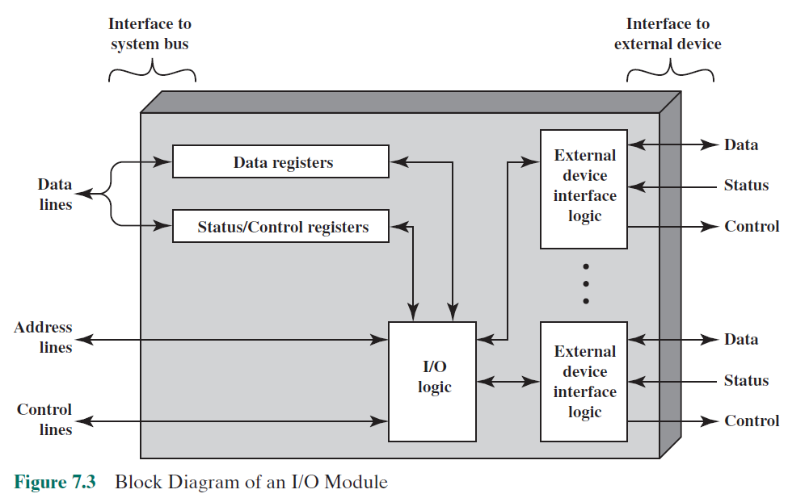
Notes:
I/O modules vary considerably in complexity and the number of external devices
that they control. We will attempt only a very general description here. (One specific
device, the Intel 82C55A, is described in Section 7.4.) Figure 7.3 provides a general
block diagram of an I/O module. The module connects to the rest of the computer
through a set of signal lines (e.g., system bus lines). Data transferred to and from the
module are buffered in one or more data registers. There may also be one or more
status registers that provide current status information. A status register may also
function as a control register, to accept detailed control information from the processor.
The logic within the module interacts with the processor via a set of control
lines. The processor uses the control lines to issue commands to the I/O module.
Some of the control lines may be used by the I/O module (e.g., for arbitration and
status signals). The module must also be able to recognize and generate addresses
associated with the devices it controls. Each I/O module has a unique address or, if
it controls more than one external device, a unique set of addresses. Finally, the I/O
module contains logic specific to the interface with each device that it controls.
An I/O module functions to allow the processor to view a wide range of devices
in a simple-minded way. There is a spectrum of capabilities that may be provided.
The I/O module may hide the details of timing, formats, and the electromechanics
of an external device so that the processor can function in terms of simple read and
write commands, and possibly open and close file commands. In its simplest form,
the I/O module may still leave much of the work of controlling a device (e.g., rewind
a tape) visible to the processor.
An I/O module that takes on most of the detailed processing burden, presenting
a high-level interface to the processor, is usually referred to as an I/O channel or
I/O processor. An I/O module that is quite primitive and requires detailed control
is usually referred to as an I/O controller or device controller. I/O controllers are
commonly seen on microcomputers, whereas I/O channels are used on mainframes.
In what follows, we will use the generic term I/O module when no confusion
results and will use more specific terms where necessary.

Slide 10
I/O Module Functions
The module connects to the rest of the computer through a set of signal lines (e.g., system bus lines).
Data transferred to and from the module are buffered in one or more data registers.
There may also be one or more status registers that provide current status information.
The logic within the module interacts with the processor via a set of control lines.
The processor uses the control lines to issue commands to the I/O module.
the I/O module contains logic specific to the interface with each device that it controls.
Notes:
I/O modules vary considerably in complexity and the number of external devices
that they control. We will attempt only a very general description here. (One specific
device, the Intel 82C55A, is described in Section 7.4.) Figure 7.3 provides a general
block diagram of an I/O module. The module connects to the rest of the computer
through a set of signal lines (e.g., system bus lines). Data transferred to and from the
module are buffered in one or more data registers. There may also be one or more
status registers that provide current status information. A status register may also
function as a control register, to accept detailed control information from the processor.
The logic within the module interacts with the processor via a set of control
lines. The processor uses the control lines to issue commands to the I/O module.
Some of the control lines may be used by the I/O module (e.g., for arbitration and
status signals). The module must also be able to recognize and generate addresses
associated with the devices it controls. Each I/O module has a unique address or, if
it controls more than one external device, a unique set of addresses. Finally, the I/O
module contains logic specific to the interface with each device that it controls.
An I/O module functions to allow the processor to view a wide range of devices
in a simple-minded way. There is a spectrum of capabilities that may be provided.
The I/O module may hide the details of timing, formats, and the electromechanics
of an external device so that the processor can function in terms of simple read and
write commands, and possibly open and close file commands. In its simplest form,
the I/O module may still leave much of the work of controlling a device (e.g., rewind
a tape) visible to the processor.
An I/O module that takes on most of the detailed processing burden, presenting
a high-level interface to the processor, is usually referred to as an I/O channel or
I/O processor. An I/O module that is quite primitive and requires detailed control
is usually referred to as an I/O controller or device controller. I/O controllers are
commonly seen on microcomputers, whereas I/O channels are used on mainframes.
In what follows, we will use the generic term I/O module when no confusion
results and will use more specific terms where necessary.

Slide 11
I/O Techniques
Three techniques are possible for I/O operations:
Programmed I/O
Data are exchanged between the processor and the I/O module
Processor executes a program that gives it direct control of the I/O operation
When the processor issues a command it must wait until the I/O operation is complete
If the processor is faster than the I/O module this is wasteful of processor time
Interrupt-driven I/O
Processor issues an I/O command, continues to execute other instructions, and is interrupted by the I/O module when the latter has completed its work
Direct memory access (DMA)
The I/O module and main memory exchange data directly without processor involvement
Notes:
Three techniques are possible for I/O operations. With programmed I/O, data are
exchanged between the processor and the I/O module. The processor executes a program
that gives it direct control of the I/O operation, including sensing device status,
sending a read or write command, and transferring the data. When the processor
issues a command to the I/O module, it must wait until the I/O operation is complete.
If the processor is faster than the I/O module, this is wasteful of processor time.
With interrupt-driven I/O, the processor issues an I/O command, continues to execute
other instructions, and is interrupted by the I/O module when the latter has completed
its work. With both programmed and interrupt I/O, the processor is responsible for
extracting data from main memory for output and storing data in main memory for
input. The alternative is known as direct memory access (DMA). In this mode, the I/O
module and main memory exchange data directly, without processor involvement.

Slide 12
I/O Commands
There are four types of I/O commands that an I/O module may receive when it is addressed by a processor:
Control
- used to activate a peripheral and tell it what to do
Test
- used to test various status conditions associated with an I/O module and its peripherals
Read
- causes the I/O module to obtain an item of data from the peripheral and place it in an internal buffer
Write
- causes the I/O module to take an item of data from the data bus and subsequently transmit that data item to the peripheral
Notes:
To execute an I/O-related instruction, the processor issues an address, specifying the
particular I/O module and external device, and an I/O command. There are four types
of I/O commands that an I/O module may receive when it is addressed by a processor:
• Control: Used to activate a peripheral and tell it what to do. For example, a
magnetic-tape unit may be instructed to rewind or to move forward one record.
These commands are tailored to the particular type of peripheral device.
• Test: Used to test various status conditions associated with an I/O module and
its peripherals. The processor will want to know that the peripheral of interest
is powered on and available for use. It will also want to know if the most
recent I/O operation is completed and if any errors occurred.
• Read: Causes the I/O module to obtain an item of data from the peripheral
and place it in an internal buffer (depicted as a data register in Figure 7.3). The
processor can then obtain the data item by requesting that the I/O module
place it on the data bus.
• Write: Causes the I/O module to take an item of data (byte or word) from the
data bus and subsequently transmit that data item to the peripheral.

Slide 13
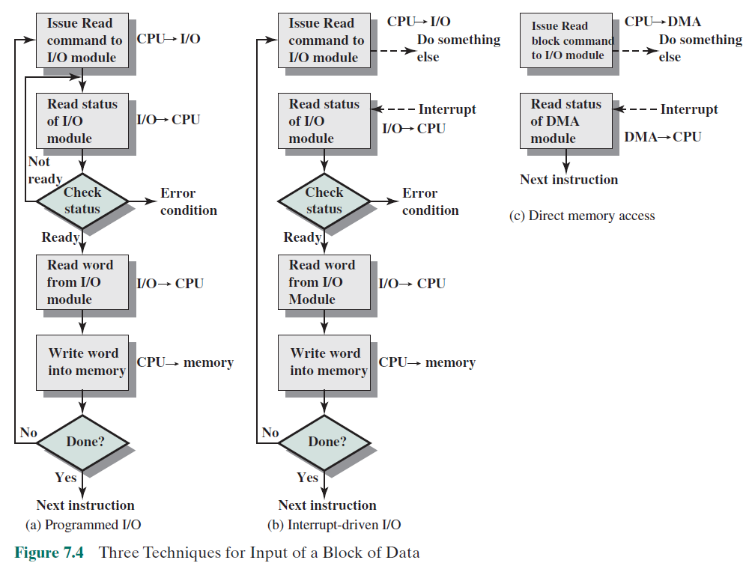
Notes:
Figure 7.4a gives an example of the use of programmed I/O to read in a block of
data from a peripheral device (e.g., a record from tape) into memory. Data are read
in one word (e.g., 16 bits) at a time. For each word that is read in, the processor must
remain in a status-checking cycle until it determines that the word is available in the
I/O module’s data register. This flowchart highlights the main disadvantage of this
technique: it is a time-consuming process that keeps the processor busy needlessly.

Slide 14
I/O Instructions
With programmed I/O there is a close correspondence between the I/O-related instructions that the processor fetches from memory and the I/O commands that the processor issues to an I/O module to execute the instructions
The form of the instruction depends on the way in which external devices are addressed
Each I/O device connected through I/O modules is given a unique identifier or address
When the processor issues an I/O command, the command contains the address of the desired device
Thus each I/O module must interpret the address lines to determine if the command is for itself
Memory-mapped I/O
There is a single address space for memory locations and I/O devices
A single read line and a single write line are needed on the bus
Notes:
With programmed I/O, there is a close correspondence between the I/O-related
instructions that the processor fetches from memory and the I/O commands that the
processor issues to an I/O module to execute the instructions. That is, the instructions
are easily mapped into I/O commands, and there is often a simple one-
to-one relationship. The form of the instruction depends on the way in which external
devices are addressed.
Typically, there will be many I/O devices connected through I/O modules to
the system. Each device is given a unique identifier or address. When the processor
issues an I/O command, the command contains the address of the desired device.
Thus, each I/O module must interpret the address lines to determine if the command
is for itself.
When the processor, main memory, and I/O share a common bus, two modes
of addressing are possible: memory mapped and isolated. With memory-mapped
I/O, there is a single address space for memory locations and I/O devices. The processor
treats the status and data registers of I/O modules as memory locations and
uses the same machine instructions to access both memory and I/O devices. So, for
example, with 10 address lines, a combined total of 2¹⁰ = 1024 memory locations
and I/O addresses can be supported, in any combination.
With memory-mapped I/O, a single read line and a single write line are needed
on the bus. Alternatively, the bus may be equipped with memory read and write
plus input and output command lines. Now, the command line specifies whether the
address refers to a memory location or an I/O device. The full range of addresses
may be available for both. Again, with 10 address lines, the system may now support
both 1024 memory locations and 1024 I/O addresses. Because the address space for
I/O is isolated from that for memory, this is referred to as isolated I/O.

Slide 15
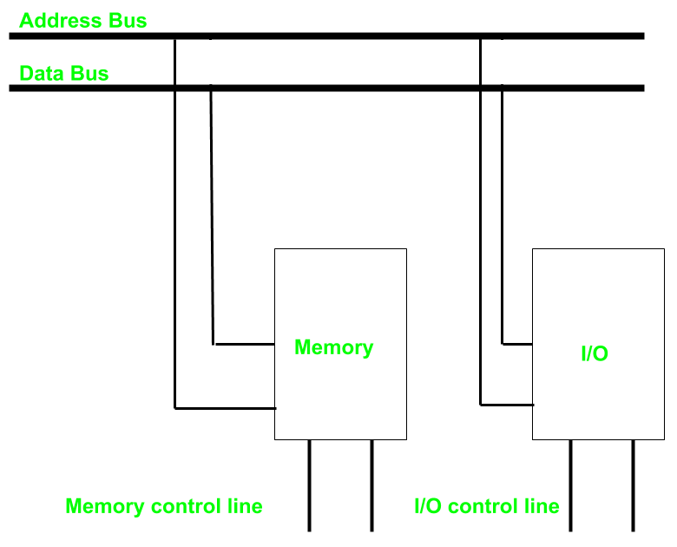
Isolated I/O
common bus(data and address) for I/O and memory
but separate read and write control lines for I/O.
So when CPU decode instruction then if data is for I/O then it places the address on the address line and set I/O read or write control line on due to which data transfer occurs between CPU and I/O.
different read-write instruction for both I/O and memory.

Slide 16
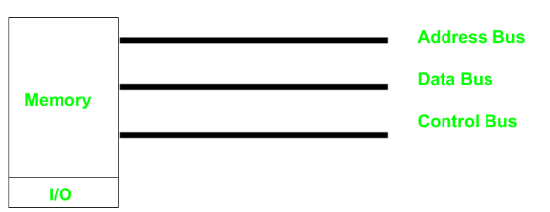
Memory-mapped I/O
Every bus in common
same set of instructions work for memory and I/O.
Hence we manipulate I/O same as memory and both have same address space,
due to which addressing capability of memory become less because some part is occupied by the I/O.

Slide 17
I/O Mapping Summary
Memory mapped I/O
Devices and memory share an address space
I/O looks just like memory read/write
No special commands for I/O
Large selection of memory access commands available
Isolated I/O
Separate address spaces
Need I/O or memory select lines
Special commands for I/O
Limited set
Notes:
I/O mapping summary.

Slide 18
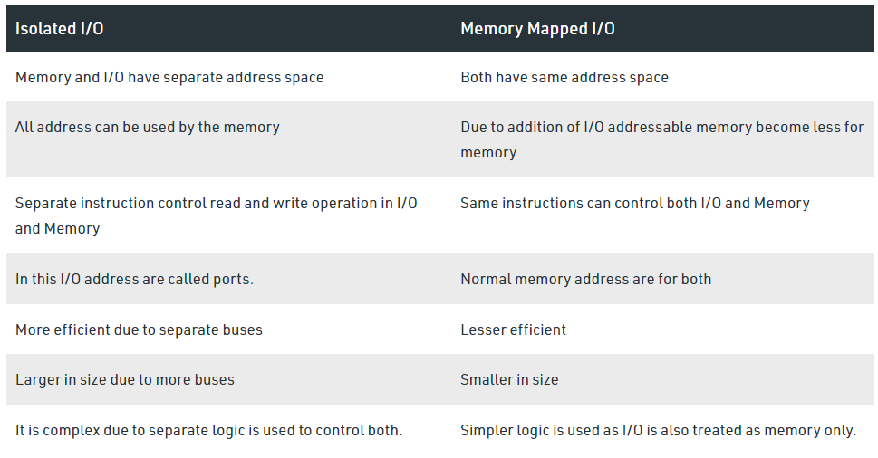
Isolated vs. Memory-mapped I/O

Slide 19
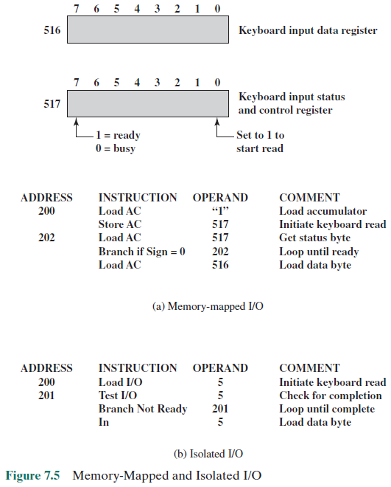
Notes:
Figure 7.5 contrasts these two programmed I/O techniques. Figure 7.5a shows
how the interface for a simple input device such as a terminal keyboard might appear
to a programmer using memory-mapped I/O. Assume a 10-bit address, with a 512-
bit memory (locations 0–511) and up to 512 I/O addresses (locations 512–1023).
Two addresses are dedicated to keyboard input from a particular terminal. Address
516 refers to the data register and address 517 refers to the status register, which
also functions as a control register for receiving processor commands. The program
shown will read 1 byte of data from the keyboard into an accumulator register in the
processor. Note that the processor loops until the data byte is available.
With isolated I/O (Figure 7.5b), the I/O ports are accessible only by special
I/O commands, which activate the I/O command lines on the bus.
For most types of processors, there is a relatively large set of different instructions
for referencing memory. If isolated I/O is used, there are only a few I/O
instructions. Thus, an advantage of memory-mapped I/O is that this large repertoire
of instructions can be used, allowing more efficient programming. A disadvantage is
that valuable memory address space is used up. Both memory-mapped and isolated
I/O are in common use.

Slide 20
Interrupt-Driven I/O
The problem with programmed I/O is that the processor has to wait a long time for the I/O module to be ready for either reception or transmission of data
An alternative is for the processor to issue an I/O command to a module and then go on to do some other useful work
The I/O module will then interrupt the processor to request service when it is ready to exchange data with the processor
The processor executes the data transfer and resumes its former processing
Notes:
The problem with programmed I/O is that the processor has to wait a long time
for the I/O module of concern to be ready for either reception or transmission of
data. The processor, while waiting, must repeatedly interrogate the status of the I/O
module. As a result, the level of the performance of the entire system is severely
degraded.
An alternative is for the processor to issue an I/O command to a module and
then go on to do some other useful work. The I/O module will then interrupt the
processor to request service when it is ready to exchange data with the processor.
The processor then executes the data transfer, as before, and then resumes its
former processing.
Let us consider how this works, first from the point of view of the I/O module.
For input, the I/O module receives a READ command from the processor. The I/O
module then proceeds to read data in from an associated peripheral. Once the data
are in the module’s data register, the module signals an interrupt to the processor
over a control line. The module then waits until its data are requested by the processor.
When the request is made, the module places its data on the data bus and is
then ready for another I/O operation.
From the processor’s point of view, the action for input is as follows. The processor
issues a READ command. It then goes off and does something else (e.g., the
processor may be working on several different programs at the same time). At the
end of each instruction cycle, the processor checks for interrupts (Figure 3.9). When
the interrupt from the I/O module occurs, the processor saves the context (e.g., program
counter and processor registers) of the current program and processes the
interrupt. In this case, the processor reads the word of data from the I/O module
and stores it in memory. It then restores the context of the program it was working
on (or some other program) and resumes execution.
Figure 7.4b shows the use of interrupt I/O for reading in a block of data.
Compare this with Figure 7.4a. Interrupt I/O is more efficient than programmed I/O
because it eliminates needless waiting. However, interrupt I/O still consumes a lot of
processor time, because every word of data that goes from memory to I/O module
or from I/O module to memory must pass through the processor.

Slide 21
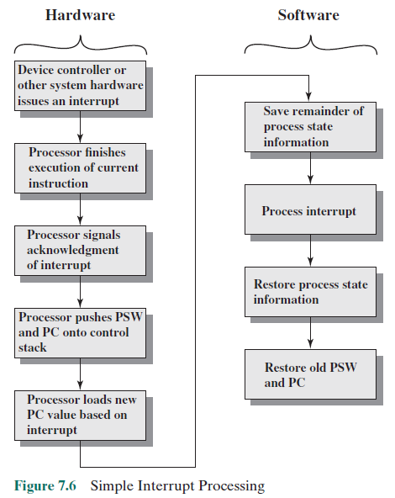
PSW =
Program Status Word
Notes:
Let us consider the role of the processor in interrupt-driven I/O in more detail.
The occurrence of an interrupt triggers a number of events, both in the processor
hardware and in software. Figure 7.6 shows a typical sequence. When an I/O device
completes an I/O operation, the following sequence of hardware events occurs:
1. The device issues an interrupt signal to the processor.
2. The processor finishes execution of the current instruction before responding
to the interrupt, as indicated in Figure 3.9.
3. The processor tests for an interrupt, determines that there is one, and sends an
acknowledgment signal to the device that issued the interrupt. The acknowledgment
allows the device to remove its interrupt signal.
4. The processor now needs to prepare to transfer control to the interrupt routine.
To begin, it needs to save information needed to resume the current program at
the point of interrupt. The minimum information required is (a) the status of the
processor, which is contained in a register called the program status word (PSW),
and (b) the location of the next instruction to be executed, which is contained in
the program counter. These can be pushed onto the system control stack.
5. The processor now loads the program counter with the entry location of the
interrupt-handling program that will respond to this interrupt. Depending on
the computer architecture and operating system design, there may be a single
program; one program for each type of interrupt; or one program for each
device and each type of interrupt. If there is more than one interrupt-handling
routine, the processor must determine which one to invoke. This information
may have been included in the original interrupt signal, or the processor may
have to issue a request to the device that issued the interrupt to get a response
that contains the needed information.

Slide 22
Drawbacks of Programmed and Interrupt-Driven I/O
Both forms of I/O suffer from two inherent drawbacks:
The I/O transfer rate is limited by the speed with which the processor can test and service a device
The processor is tied up in managing an I/O transfer; a number of instructions must be executed for each I/O transfer
When large volumes of data are to be moved a more efficient technique is direct memory access (DMA)
Notes:
Interrupt-driven I/O, though more efficient than simple programmed I/O, still
requires the active intervention of the processor to transfer data between memory
and an I/O module, and any data transfer must traverse a path through the processor.
Thus, both these forms of I/O suffer from two inherent drawbacks:
1. The I/O transfer rate is limited by the speed with which the processor can test
and service a device.
2. The processor is tied up in managing an I/O transfer; a number of instructions
must be executed for each I/O transfer (e.g., Figure 7.5).
There is somewhat of a trade-off between these two drawbacks. Consider the
transfer of a block of data. Using simple programmed I/O, the processor is dedicated
to the task of I/O and can move data at a rather high rate, at the cost of doing
nothing else. Interrupt I/O frees up the processor to some extent at the expense of
the I/O transfer rate. Nevertheless, both methods have an adverse impact on both
processor activity and I/O transfer rate.
When large volumes of data are to be moved, a more efficient technique is
required: direct memory access (DMA).

Slide 23
Trade-offs
There is somewhat of a trade-off between these two drawbacks.
Consider the transfer of a block of data.
Using simple programmed I/O, the processor is dedicated to the task of I/O and can move data at a rather high rate, at the cost of doing nothing else.
Interrupt I/O frees up the processor to some extent at the expense of the I/O transfer rate.
Nevertheless, both methods have an adverse impact on both processor activity and I/O transfer rate.

Slide 24
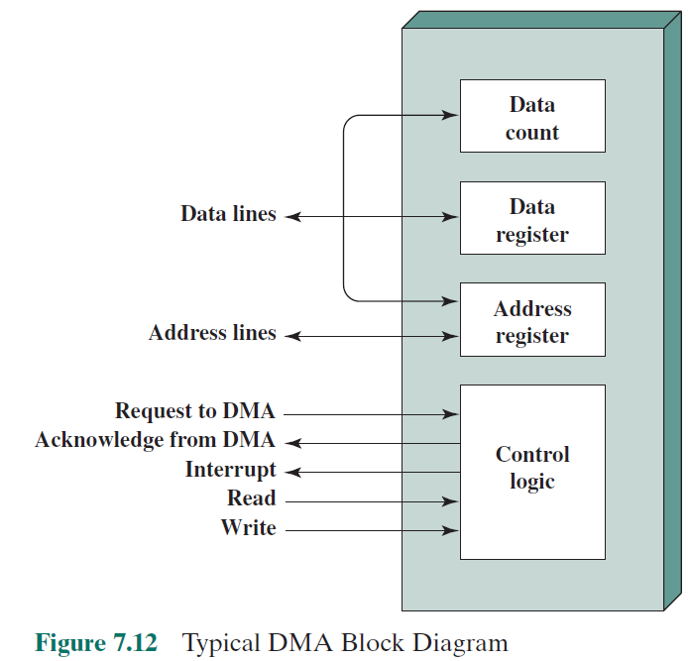
Direct Memory Access (DMA)
Notes:
DMA involves an additional module on the system bus. The DMA module
(Figure 7.12) is capable of mimicking the processor and, indeed, of taking over
control of the system from the processor. It needs to do this to transfer data to
and from memory over the system bus. For this purpose, the DMA module must
use the bus only when the processor does not need it, or it must force the processor
to suspend operation temporarily. The latter technique is more common and is
referred to as cycle stealing, because the DMA module in effect steals a bus cycle.
When the processor wishes to read or write a block of data, it issues a
command to the DMA module, by sending to the DMA module the following
information:
• Whether a read or write is requested, using the read or write control line
between the processor and the DMA module
• The address of the I/O device involved, communicated on the data lines
The starting location in memory to read from or write to, communicated on
the data lines and stored by the DMA module in its address register
• The number of words to be read or written, again communicated via the data
lines and stored in the data count register
The processor then continues with other work. It has delegated this I/O operation
to the DMA module. The DMA module transfers the entire block of data, one
word at a time, directly to or from memory, without going through the processor.
When the transfer is complete, the DMA module sends an interrupt signal to the
processor. Thus, the processor is involved only at the beginning and end of the
transfer (Figure 7.4c).

Slide 25
Direct Memory Access (DMA)
The DMA module is capable of taking over control of the system from the processor.
It needs to do this to transfer data to and from memory over the system bus.
Cycle Stealing:
the DMA module must use the bus only when the processor does not need it, or it must force the processor to suspend operation temporarily.
the DMA module in effect steals a bus cycle.
Notes:
DMA involves an additional module on the system bus. The DMA module
(Figure 7.12) is capable of mimicking the processor and, indeed, of taking over
control of the system from the processor. It needs to do this to transfer data to
and from memory over the system bus. For this purpose, the DMA module must
use the bus only when the processor does not need it, or it must force the processor
to suspend operation temporarily. The latter technique is more common and is
referred to as cycle stealing, because the DMA module in effect steals a bus cycle.
When the processor wishes to read or write a block of data, it issues a
command to the DMA module, by sending to the DMA module the following
information:
• Whether a read or write is requested, using the read or write control line
between the processor and the DMA module
• The address of the I/O device involved, communicated on the data lines
The starting location in memory to read from or write to, communicated on
the data lines and stored by the DMA module in its address register
• The number of words to be read or written, again communicated via the data
lines and stored in the data count register
The processor then continues with other work. It has delegated this I/O operation
to the DMA module. The DMA module transfers the entire block of data, one
word at a time, directly to or from memory, without going through the processor.
When the transfer is complete, the DMA module sends an interrupt signal to the
processor. Thus, the processor is involved only at the beginning and end of the
transfer (Figure 7.4c).

Slide 26
Direct Memory Access (DMA)
The processor issues a command to the DMA module
Read or Write Signal
The address of the I/O device involved
The starting location in memory to read from or write to
The number of words to be read or written
The processor then continues with other work.
It has delegated this I/O operation to the DMA module.
The DMA module transfers the entire block of data, one word at a time, directly to or from memory, without going through the processor.
When the transfer is complete, the DMA module sends an interrupt signal to the processor.
Thus, the processor is involved only at the beginning and end of the transfer
Notes:
DMA involves an additional module on the system bus. The DMA module
(Figure 7.12) is capable of mimicking the processor and, indeed, of taking over
control of the system from the processor. It needs to do this to transfer data to
and from memory over the system bus. For this purpose, the DMA module must
use the bus only when the processor does not need it, or it must force the processor
to suspend operation temporarily. The latter technique is more common and is
referred to as cycle stealing, because the DMA module in effect steals a bus cycle.
When the processor wishes to read or write a block of data, it issues a
command to the DMA module, by sending to the DMA module the following
information:
• Whether a read or write is requested, using the read or write control line
between the processor and the DMA module
• The address of the I/O device involved, communicated on the data lines
The starting location in memory to read from or write to, communicated on
the data lines and stored by the DMA module in its address register
• The number of words to be read or written, again communicated via the data
lines and stored in the data count register
The processor then continues with other work. It has delegated this I/O operation
to the DMA module. The DMA module transfers the entire block of data, one
word at a time, directly to or from memory, without going through the processor.
When the transfer is complete, the DMA module sends an interrupt signal to the
processor. Thus, the processor is involved only at the beginning and end of the
transfer (Figure 7.4c).

Slide 27
Summary
Input/Output
Chapter 7
Interrupt-driven I/O
External devices
Keyboard/monitor
Disk drive
I/O modules
Module function
I/O module structure
Programmed I/O
Overview of programmed I/O
I/O commands/instructions
Direct memory access
Drawbacks of programmed and interrupt-driven I/O
DMA function
Notes:
Chapter 7 summary.

